Slide 1
Computational model of cancer stem cell dynamics
Submitted By
Rahul Kulkarni
CE, Dept of CS & E,
SJCE, Mysore.
Internal Guide
Dr.M.A.Anusuya
Assistant Professor,
Dept of CS & E,
SJCE, Mysore.
Panel
Mrs. Manjula.S
Assistant Professor,
Dept of CS & E,
SJCE, Mysore.
External Guide
Dr.Shamik.Sen
Assistant Professor,
Dept of BS & BE,
IIT B, Mumbai.

Slide 2
INTRODUCTION
Computational model
Studies the behavior of a complex system by computer simulation
Common computational models are weather forecasting models, earth simulator models, flight simulator models, molecular protein folding models

Slide 3
INTRODUCTION
Stem cells
Undifferentiated biological cells that can differentiate into specialized cells
Cancer stem cells (CSCs)
Cancer cells found within tumors with ability to give rise to all cell types found in a cancer sample

Slide 4
INTRODUCTION
For theoretical model of a generalised stem-cell driven tissue with a simple microenvironment - computational model which is a hybrid, discrete/continuous computational cellular automaton model
Cellular automaton consists of a regular grid of cells, each in one of a finite number of states

Slide 5
INTRODUCTION
Subpopulation of tumour cells, called TICs
Transient Amplifying Cells (TACs)
Terminally Differentiated Cells (TDs)
Hierarchical Model (HM)

Slide 6
INTRODUCTION

Slide 7
PROBLEM STATEMENT
To develop a computational model based on the available experimental data to gain further insights about the origin of CSCs and their role in promoting cancer.
By applying discrete models, automata theory, and cellular automaton programming to create more accurate models of population growth and a better understanding of population dynamics.

Slide 8
PROBLEM STATEMENT
A two dimensional computational model of the HM of a TIC-driven tissue. And to generalise the intrinsic alterations which a TIC could undergo much in the same way that the hallmarks of cancer have generalised non TIC-specific alterations.
Computational predictions will be experimentally tested by PhD students in the lab.

Slide 9
MOTIVATION
Following chemotherapy, CSCs left behind would be able to replenish a tumor and cause a relapse of the cancer
Tumor modeling and understanding relapse due to CSCs are currently ill understood because most organisms with relapse cancers in vitro die before they can be further studied
Development of specific therapies targeted at CSCs holds hope for improvement of survival and quality of life of cancer patients

Slide 10
OBJECTIVES AND SCOPES
Successful completion of the problem will contribute to our understanding of how CSCs contribute to cancer invasiveness
Considering the parameters in the model as non-specific, they could apply to any tissue TIC and do not assume specific genetic mutations.

Slide 11
OBJECTIVES AND SCOPES
Parameters being addressed:
Symmetric/asymmetric division rate of stem cells (α)
Number of allowed divisions of TACs (β)
Lifespan of TDs (γ)

Slide 12
DESCRIPTION OF THE WORK
Cell types to simulate:
CSC
TAC
TDC
Extra Cellular Matrix Site ( ES , where E stands for ECM Extra Cellular Matrix )

Slide 13
DESCRIPTION OF THE WORK
The rules to update the state of cells are based on parameters:
α : P( CSC dividing into TAC )
1 - α : P( CSC dividing into CSC )
β : Number of divisions of TAC ( after which they transform into TDC )
γ : Life time of TDC

Slide 14
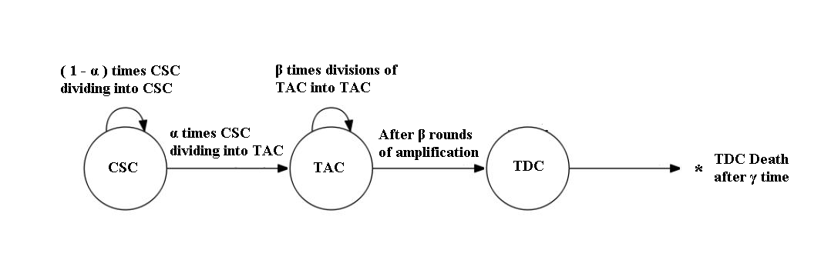
DESCRIPTION OF THE WORK

Slide 15
DESCRIPTION OF THE WORK
Tools and programming to be used:
Using C++ in Dev C ++ IDE
Doxygen to generate documentation out of program
Octave to generate images and graphs
GitHub for version control

Slide 16
CONCULSION
Learning outcomes on successful completion will be to understanding to develop computational models for getting insights into biological problems.
A cellular automata simulation of generalised stem-cell driven tissue with a simple microenvironment.

Slide 17
REFERENCES
[1] Jacob G. Scott, Anita B. Hjelmeland, Prakash Chinnaiyan, Alexander R. A. Anderson, David Basanta : Microenvironmental Variables Must Influence Intrinsic Phenotypic Parameters of Cancer Stem Cells to Affect Tumourigenicity, PLOS Computational Biology, e1003433, Volume 10, Issue 1, 7 January 2014

Slide 18
REFERENCES
[2] James M. Osborne, Miguel O. Bernabeu, Maria Bruna, Ben Calderhead, Jonathan Cooper, Neil Dalchau, Sara-Jane Dunn, Alexander G. Fletcher, Robin Freeman, Derek Groen, Bernhard Knapp, Greg J. McInerny, Gary R. Mirams, Joe Pitt-Francis, Biswa Sengupta, David W. Wright, Christian A. Yates, David J. Gavaghan, Stephen Emmott, Charlotte Deane : Ten Simple Rules for Effective Computational Research, PLOS Computational Biology, e1003506, Volume 10, Issue 1, March 2014

Slide 19
REFERENCES
[12] Andrew Q. Ninh : Two Discrete Stochastic Cellular Automata Models of Cancer Stem Cell Proliferation, International Journal of Bioscience, Biochemistry and Bioinformatics, Vol. 3, No. 5, September 2013

Slide 20
THANK YOU

